Slide 1
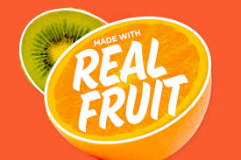
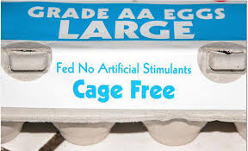
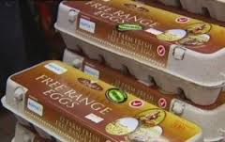
What do these labels mean to you?

Slide 2
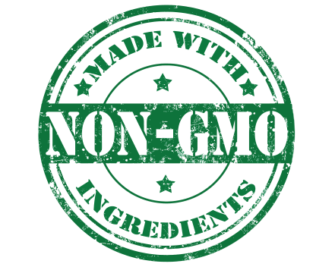
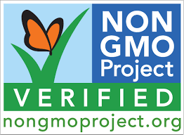
Have you seen these labels?
Are there any food labels that could be misleading or meaningless?

Slide 3
Make 2 piles of cards
True non-GMO
Food Labels
Misleading non-GMO
Food Labels
“Imposters”

Slide 4
Crops that have been genetically modified:
Alfalfa
Canola
Corn (field and sweet)
Cotton
Papaya
Potatoes
Soybeans
Squash
Sugar Beets
Granny Smith Apple

Slide 5
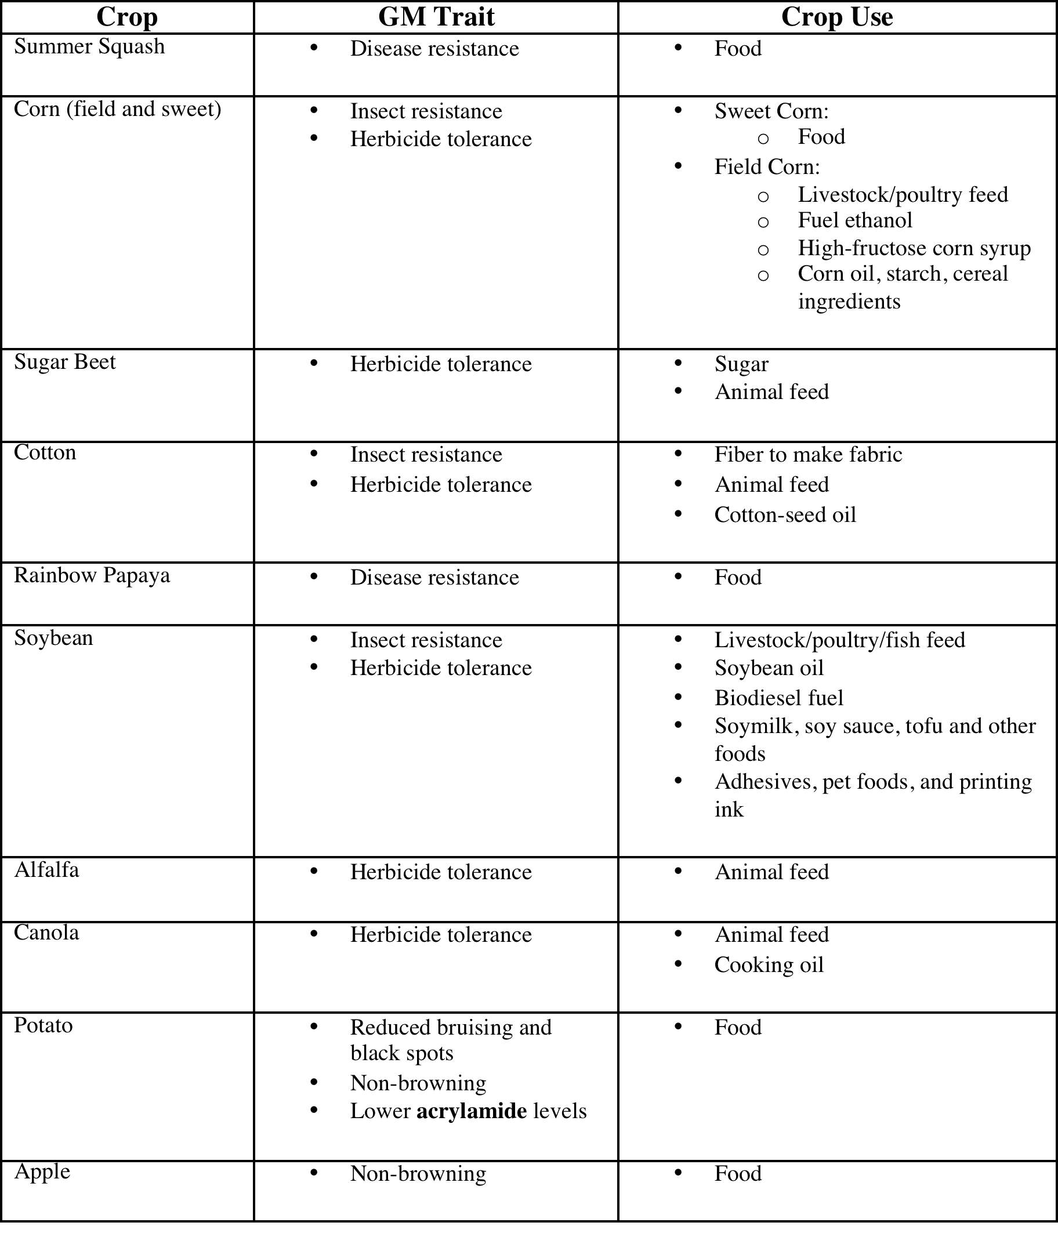
GMO Crop Table

Slide 6
Bioengineered Crops are:
Bioengineered Crops are NOT:
Plants with one or more genetic characteristics that were inserted into the genome using biotechnology.
Plants that were improved through artificial selection processes like cross breeding, hybridization, or mutagenesis.

Slide 7
Growing a Bioengineered Crop
Growing a non-Bioengineered Crop
Desired traits can be fairly quickly identified (<10 years)
Desired traits can be identified. It may take a significant amount of time (decades) to find.
Desired traits can be identified and perpetuated
Plants can become genetically resistant to disease or pests.
Disease and pests are controlled with chemicals or other cultivation practices.
Life cycle and growth of plant is equivalent
Safety and nutrition of plant is equal.
Scientists can find a single specific trait and insert it into the DNA.
Desired traits cannot be perpetuated individually.

Slide 8
Bioengineering Regulation Process
It takes many years for a new GM crop to be developed, tested, and finally approved for commercial release.
Prior to the release of a new GM crop it is tested and monitored by the following agencies
Health Canada
Canadian Food Inspection Agency (CFIA)

Slide 9
Health Canada
All novel GM foods must be tested to ensure they are as safe and nutritious as food currently sold in Canada
Requirement include:
Microbiological and chemical safety
Potential allergic reactions
Possibility of introducing new toxins into the food
Development of the food including genetic changes
Nutritional content

Slide 10
Canadian Food Inspection Agency
The Canadian Food Inspection Agency is dedicated to safeguarding food, animals and plants, which enhances the health and well-being of Canada's people, environment and economy.

